Slide 1
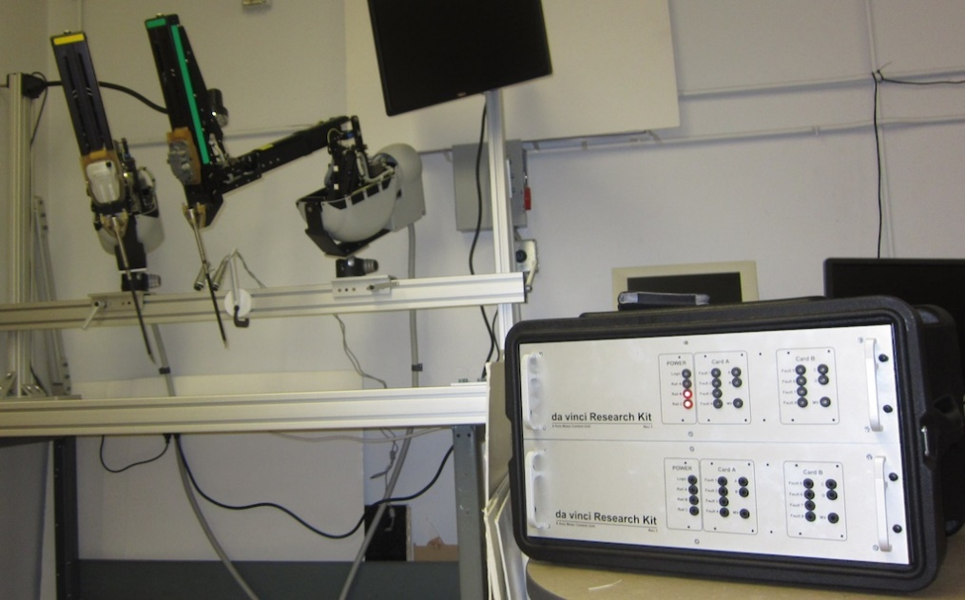

Robot Dynamics RBE-501 Spring 2016
Admittance Control of the dVRK PSM
Final Presentation
Team # 3

Slide 2
Akanksha Devkar Aman Rana Amit Trivedi Kiran Mohan Terence Carmichael
Team Members

Slide 3
Agenda
Introduction to dVRK
Problem Statement
Objectives
Project Plan
Overview of Process
Primary Purpose – Impedance Controller
Secondary Purpose – Haptic Feedback
Challenges
Deliverables proposed vs actual
Summary
Notes:
Model design, Mathematical representation, Simulation of model, Analysis of result, Trade-off of model

Slide 4
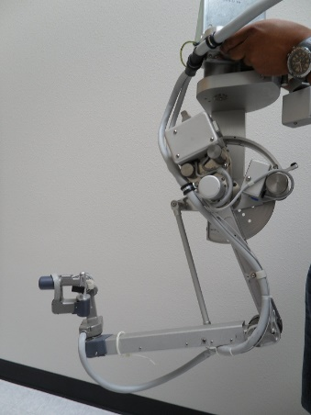
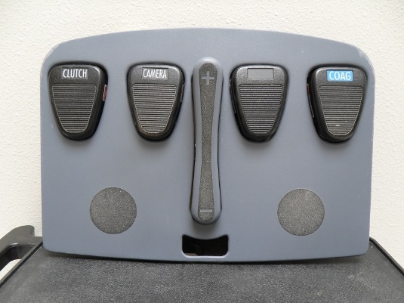
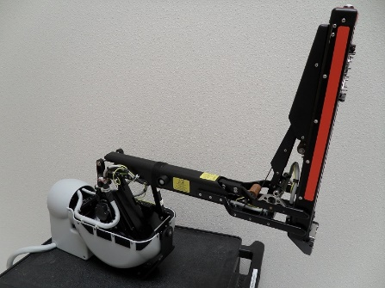
Introduction
Why Da Vinci vs Regular Laparoscopy?
Smaller incision,
less pain and scaring,
faster recovery,
less loss of blood, and
Lower infection.
Hardware
Da Vinci Research Kit (dVRK) Robot is a surgical robot created by Intuitive Surgical for research purposes by universities.
Components
Surgeon’s console - consists of two Master Tool Manipulators (MTM), 8 DOF, and a foot-pedal tray.
Patient side console - consists of two Patient Side Manipulators (PSM)
MTM
PSM
Foot Pedal Tray

Slide 5
Problem Statement
A challenge for surgeons performing teleoperation with surgical manipulators is to be able to maintain the required contact force at the tool tip when interacting with the tissue.
Additionally, it is challenging for the surgeons to experience or estimate the feeling of the mechanical properties of tissue during surgery.

Slide 6
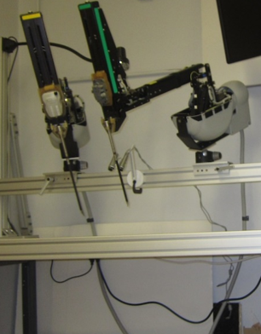
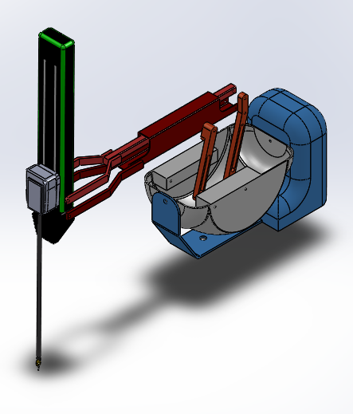
Objectives
Primary Objective
To achieve force regulation by implementing active impedance controller for the patient side manipulator (PSM) during simulation.
Secondary Objective
To develop a force feedback that would produce a simulation of the contact force at the PSM tip at the at the surgeon side manipulator (MTM).
Overachieving Objective
To apply the simulation model and computation to the physical da Vinci Research Kit in AIM lab (WPI).
Notes:
Primary Objective: To maintain the deflection of a soft body as the PSM tip pushes against the body.
Primary Measurement: Monitoring the change in the PSM tip position and measuring the output current of the joint motors and the Jacobian to compute the PSM tip contact force.
Secondary Objective: To provide the operator of the MTM to experience the force at the PSM tip.
Secondary Measurement: Monitor the contact force at the PSM tip and to measure the artificially produced force by the modeled actuator/sensor system at the MTM.

Slide 7
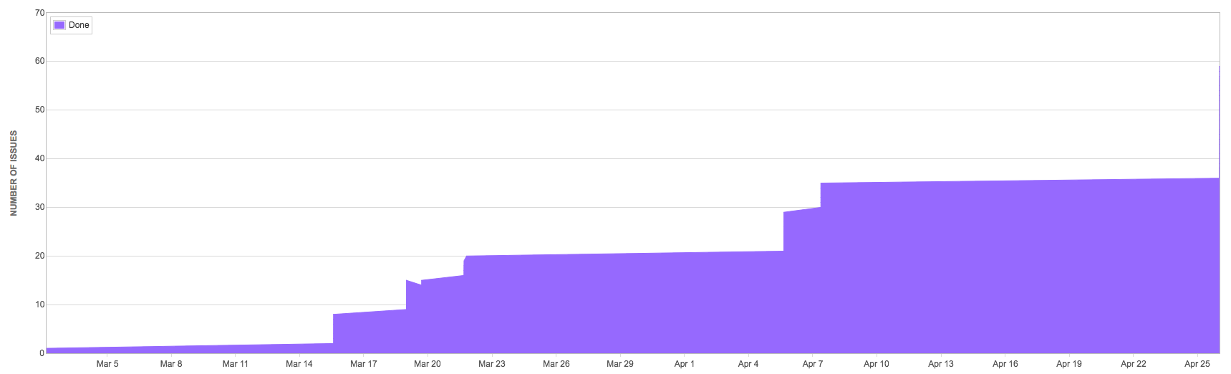
Project Management
Project planning and tracking tool – Jira
Two sub-team for tacking each objective –
Team A – Haptic Feedback model and simulation
Team B – Impedance controller model and simulation
Source code, version control and primary documentation – git
Communication tool – Slack and Uber Conference
Notes:
For project management, task breakdown and tracking progress we used Jira. The figure here shows the cumulative quantity of tasks that were worked on in the displayed timeline.
As you can see the tasks kept growing as the project progressed and if you notice to the very right there is a slight spike.
That is due to tasks that were pending were done. These were pending as we had issues with the program and simulation.
Since we were a team of 5 for efficiency we created two sub-teams. One team working on the primary objective – implementing impedance controller and the other team working on implementing the haptic feedback.
Source code was developed in Matlab and we used git for version control, sharing of code and primary project documentation.
For communication and sharing of reference materials we used Slack and Uber Conference for conference calls.

Slide 8
Overview of Process
Force Regulation
Inverse kinematics as a way to control joint position for regulating tool tip position
Inverse dynamics control law for developing active impedance controller
Force Feedback
Combination of tactile and haptic feedback. At the PSM side, tactile sensors will monitor the texture of tissue and haptic feedback will help in manipulating the actions taken on MTM side.
Notes:
For the process we explored doing pursuing using Inverse Kinematics as a way to do position control and doing impedance control.
With further review of literature we ended up using resolved acceleration as a way to do position and hence implement impedance. Control.

Slide 9
Impedance Controller Mathematical Representation
Dynamics Control Law
Impedance Controller
1
2
3
4
5
6
Notes:
The manipulator in general is a non-linear system with joints that are coupled which makes it challenging to control.
So in order to linearize and de-couple the mechanical system the inverse dynamics control law shown in equation-1 is used which was developed from differential kinematics and Lagrangian.
This equation basically is the Proportional Derivative controller with gravity compensation and provides regulation to a desired EE position and Orientation.
The terms on the left side of equation-1 are – Inertia matrix, Coriolis matrix and the Gravity matrix.
This indicates that the dynamic parameters depend on - the mass, the first moment of inertia, the inertia tensor of each link and the friction of coefficient of each joint.
If we make he = 0, meaning there is no force/moment at the end-effector. Thus implying that EE has no interaction with the environment. Which is represented in equation-2
But when the EE is in contact then from inverse dynamics control law we get Equation 3 which indicates nonlinear coupling term due to the contact force.
In this a-q represents resolved acceleration in terms of the joint variables as shown in equation-4.
Thus, we can get a relationship between EE position/orientation error, x-tilda and the EE contact force and moment, the h-e vector. The relationship is given by P(q) which is basically active impedance.

Slide 10
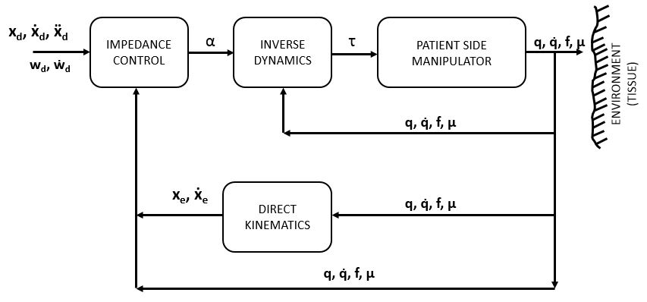
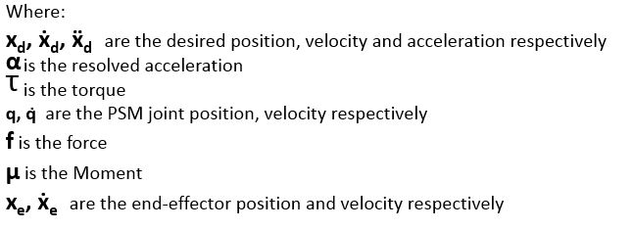
Impedance Controller Model
K_{P}
M_{d}
F
K_{D}
Notes:
The block diagram shown is the representation of the mathematical model we discussed.
For this closed-loop control the desired trajectory, desired linear velocity and desired linear acceleration is known. We apply input torques to the manipulator to reduce the position error.
This input torque is obtained from the inverse dynamics control as discussed in the previous slide, where basically we are solving for the joint acceleration based on the input resolved acceleration.
The impedance controller basically provides the resolved acceleration and thus regulates the contact force and moment of the EE.

Slide 11
Impedance Controller Simulation of Model
Model simulated in Matlab
[Either have embedded video or have link to YouTube]

Slide 12
Impedance Controller Analysis of Result
Results from varying Kd and Kp
Plots for various Kd and Kp
Statistical Analysis of simulation on model
ANOVA

Slide 13
Impedance Controller Trade-Off
The model does not provide accurate tracking of the desired position and orientation.
Simulated model not recommended for real hardware.
The actuators are assumed to be ideal torque generators.
Non-linear effects are ignored.
The contact force is large at steady state.
Kp can be reduced to reduce contact force but will result in larger position error.
Notes:
The model does not provide accurate tracking of the desired position and orientation especially when in free space.
The simulated model will not perform as presented when implemented on real hardware since -
The actuators are assumed to be ideal torque generators.
Only viscous forces are considered.
Non-linear effects such as Stribeck effects and Columb Frictions are ignored. The reason being the joint friction is not easy to model.
The contact force is large at steady state.
Kp can be reduced to reduce contact force but will result in larger end-effector position error.

Slide 14
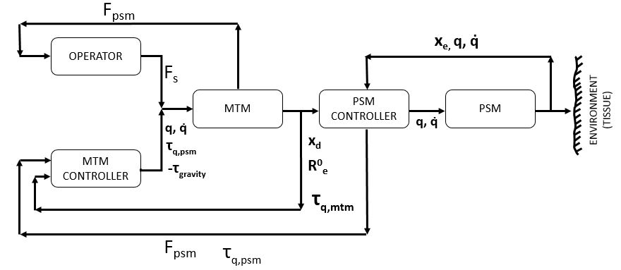
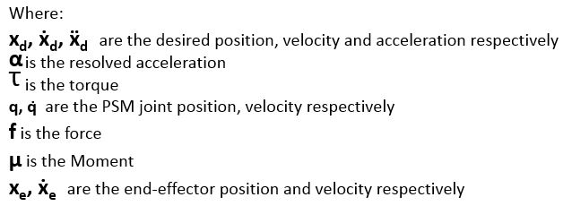
Haptic Feedback Model

Slide 15
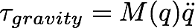
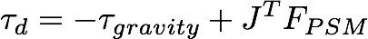
Haptic Feedback Mathematical Representation
Control Law:
M —> 0 and C —> 0.
So torque due to gravity,
The desired torque to apply for force feedback,
where, J^{T} is Jacobian of the MTM
FPSM is the Force feedback from the PSM

Slide 16
Haptic Feedback Simulation of Model
[Model simulated in Matlab and Simulink]
[Either have embedded video or have link to YouTube]

Slide 17
Haptic Feedback Analysis of Result
[Simulation results and plots]

Slide 18
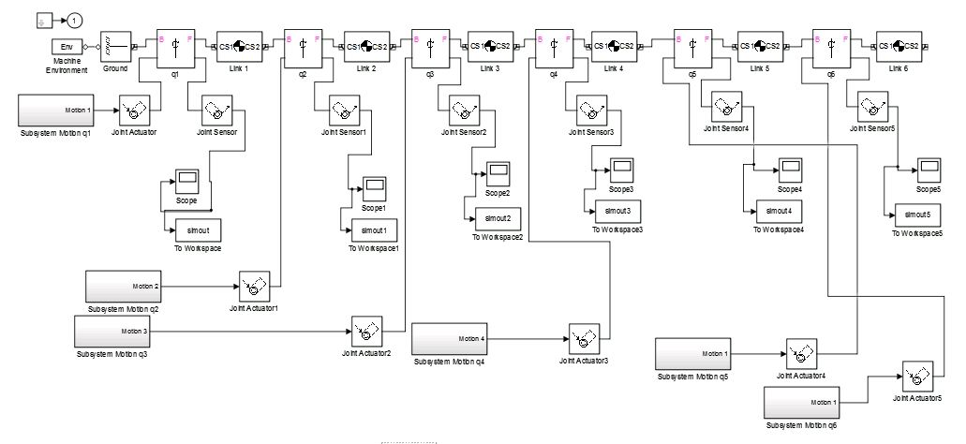
Haptic Feedback Trade-Off
Proposed method for validating Haptic Feedback by use of SimMechanics.
It is important to account for the DH parameters of the imported models, during model import, world frames are altered from original orientation.

Slide 19
Overall Challenges
Infrastructure availability
Team skillset
Domain of tasks involved
Documentation on dVRK
Literature reviews
Approach for developing model
Dynamic model parameter values
Implementation and computational complexity of algorithm

Slide 20
Deliverables Proposed vs Actual
PROPOSED DELIVERABLE | STATUS
Project Plan | Completed
Requirements Document | Completed
Model for Impedance Controller | Completed
Computational Results for Impedance Controller | Completed
Simulation of Impedance Controller Model for PSM | Completed
Optimal Interaction Control | Not Completed
Model for Haptic Feedback | Completed
Computational Results for Haptic Feedback | Completed
Simulation of Haptic Feedback Model for MTM | Completed
Risk Analysis | Completed
IEEE format paper | Completed
Notes:
We plan to obtain a thorough understanding of optimal interaction control which will help us find the optimal interaction control by adjusting the gains and damping parameters.
At the end of project we plan to demonstrate the model with simulation and overachieving goal is to be able to do physical demonstration with the da Vinci kit by pulling a string held by the PSM to show use of admittance control.
Deliverables achieved – Our team was able to achieve the primary objective of developing an active impedance controller and implementing it as a simulation for the PSM. We were also able to develop a haptic feedback and implement it as a simulation.

Slide 21
Summary
Introduction to dVRK
Problem Statement and Objectives
Project Plan
Primary Objective – Active Impedance Controller
Model design, Mathematical representation, Simulation of model, Analysis of result, Trade-off of model
Secondary Objective – Haptic Feedback
Model design, Mathematical representation, Simulation of model, Analysis of result, Trade-off of model
Challenges
Deliverables proposed vs actual

Slide 22
THANK YOU

Slide 23
Outline
Team Introduction
Agenda
Problem Statement
Objectives
Deliverables achieved
Project Plan
Overview of Process
Primary Purpose – Impedance Controller
Model design
Mathematical representation
Simulation of model + video
Analysis of result
Secondary Purpose – Haptic Feedback
Model design
Mathematical representation
Simulation of model + video
Analysis of result
Trade off models
Challenges
Deliverables proposed vs actual
Summary

Slide 24
Scope and Execution
Scope
Simulate admittance control of the PSM by regulating contact force at the end effector.
Modeling the simulation of haptic feedback on the MTM based on the force at the PSM tip.
Implement the simulation in the hardware.
The project will be done within the scope of the topics covered in the course RBE-501.
The robotic system being used is Intuitive Surgical’s daVinci Research Kit (dVRK).
Feasibility
Simulating admittance control is our primary objective and needs only computers as resources and is hence, completely feasible within the given time frame.
Haptic feedback is our secondary objective and requires computing resources.
Hardware implementation requires the most resources like the physical da Vinci system and more time and hence may be the least feasible objective.
Domains covered
Admittance control and haptic feedback require sound knowledge in Robot Dynamics and Robot Control and skills like robot modeling, simulation and sensor integration.

Slide 25
Deliverables
Primary deliverable
Project plan
Requirements document
Computational results
Dynamics and kinematics
Implementation of an admittance controller for the PSM
Optimal interaction control findings
Model for monitoring force at PSM and generating real-time equivalent force at the MTM
Demonstration of the results
Final project report
Secondary deliverable
Risk analysis
Tertiary deliverable
IEEE publication of the project objectives and results.
Notes:
We plan to obtain a thorough understanding of optimal interaction control which will help us find the optimal interaction control by adjusting the gains and damping parameters.
At the end of project we plan to demonstrate the model with simulation and overachieving goal is to be able to do physical demonstration with the da Vinci kit by pulling a string held by the PSM to show use of admittance control.

Slide 26
Timelines
S No | Activity | Timeline
1 | Written proposal | Feb-18
2 | Project Plan | Feb-26
3 | Requirements document | Feb-26
4 | Evaluate Inverse Kinematics | Mar-04
5 | Evaluate Forward Kinematics | Mar-11
6 | Simulation model for monitoring force at PSM | Mar-25
7 | Risk Analysis | Apr-01
8 | Complete Simulation | Apr-07
9 | Modifications and Improvements | Apr-19
10 | Final project presentation | Apr-26

Slide 27
Challenges
Challenges
Physical and Virtual System implementation
Multiple users working on one product.
Level of Effectiveness
Team Aspect:
Deliverables
Priorities
Logistics
Solutions
Implementing a comprehensive verification and validation plan.
Utilizing revision control software throughout the course of development.
Thorough Research & Analysis of past and present surgical technology.
Consistent communication and strategic planning of our tasks and activities.

Slide 28
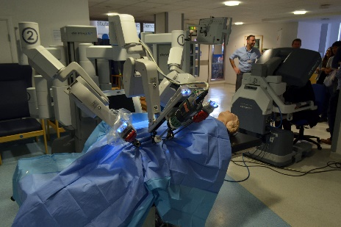
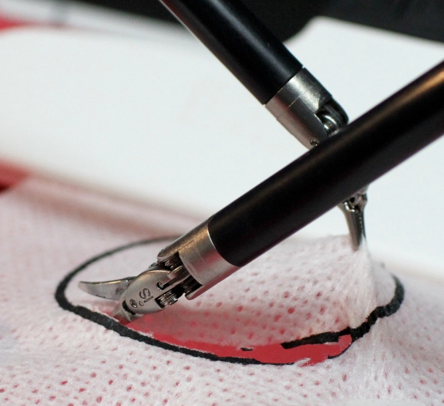
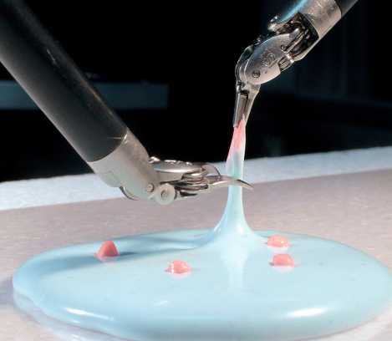
Audience
Primary audience
Students and researchers working in the field of robotics, mechanical and instrumentation engineering
Secondary audience
Faculty in the field of robotics engineering
Tertiary audience
Medical Industry: For surgical robot manipulators
Electronic Industry: For handling thin wafers
Food Industry: Handling fragile food items
Automation Industry: Handling ceramic catalytic converters
Casting Industry: Handling wax patterns in investment casting
Space Exploration: Handling fragile evidences in outer space

